Slide 1
Analysis of How International Environmental Policies Impact Pollution & Biodiversity
Stacy Marshall, Delphine Albrecht and Ghazi Muhammad

Slide 2
Workflow
Data collection
Data cleaning
Data analysis
OECD DataBase
WWF DataBase
Data structure analysis
Data cleaning
Data conversion
Data comparison
Correlations

Slide 3
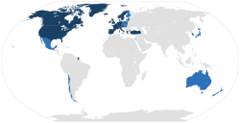
Collection of the datasets used in this project
Organisation for Economic Co-operation and Development
Created in 1961 by 18 European countries, the US and Canada
Created to promote policies that will improve the economic and social well-being of people
Today, 36 Member countries span the globe, from North and South America to Europe and Asia-Pacific.
Large number of topics going from agriculture to Education, Energy, Environment, Finance, Health ...
Open access
Founding member countries (1961)
Other member countries

Slide 4
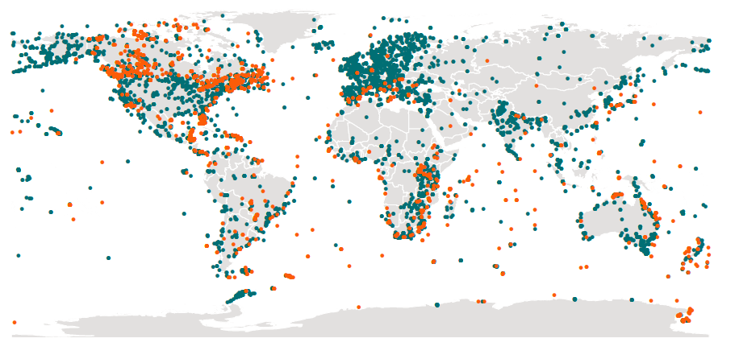
Collection of the datasets used in this project
World Wildlife Fund (WWF)
Created in 1961, WWF is a non-governmental organisation
Created to work in the field of the wilderness preservation, and the reduction of human impact on the environment
The world's largest conservation organization with over five million supporters worldwide, working in more than 100 countries
Collaboration with OECD
Open access data
Data collection points (the most recent are in orange)

Slide 5
Workflow
Data collection
Data cleaning
Data analysis
OECD DataBase
WWF DataBase
Data structure analysis
Data cleaning
Data conversion
Data comparison
Correlations

Slide 6
Question definition and datasets cleaning
Defining our question based on the data availability
We wanted to make a data analysis concerning environment and biodiversity
The OECD combined with the WWF data base gave us a great source of data
We chose to define our question based on the available data :
“ How much does the environmental policy of a country impact on
its CO2 production, pollution or biodiversity? ”
Selecting relevant Data
- The OECD database has an incredible amount of Data available. For example for Air & Climate, we have access to :
Emissions of air pollutants : Total man-made emissions, Total mobile sources, Total stationary sources, Industrial combustion, Other combustion, Agriculture, Waste, Total emission intensities ...
Each of this categories are available for Sulphur Oxides, Nitrogen Oxides, Particulates (PM10 or PM2.5), Carbon monoxide or Non-methane volatile Organic compounds.
But also the greenhouse gas emission by sources more specifically ...
- We had to better understand each category and select relevant datasets

Slide 7
Workflow
Data collection
Data cleaning
Data analysis
OECD DataBase
WWF DataBase
Data structure analysis
Data cleaning
Data conversion
Data comparison
Correlations

Slide 8
Controlling For Differences in Country Size and Baseline Pollution Levels

Slide 9
Controlling For Differences in Country Size and Baseline Pollution Levels

Slide 10
Narrowing Our Focus To Select Countries
These 4 countries appeared to use as particularly interesting to study as all of them had a wide variety of data available.
Moreover, in contrast to the other countries, Canada seems to have a decreased biodiversity since 1974. Is there anything specific to Canada compare to the other countries that could correlate to this observation?
Notes:
Taking two countries in one continent and compare them to each other and to the another continent seemed to us as relevant for our question.

Slide 11
Comparison of CO2 production and law enforcement
Over the past 20 years, both France and Austria have increased their environmental policy stringency and interestingly this correlates with a decrease in their production of CO2 emission.
This decrease doesn’t seems to be affected by the amount of Tax revenue spend.
Notes:
Taking two countries in one continent and compare them to each other and to the another continent seemed to us as relevant for our question.

Slide 12
Comparison of CO2 production and law enforcement
Over the past 20 years, both the United States and Canada have also increased their environmental policy stringency BUT interestingly their outcomes are different. While the United Stated decreased their CO2 emission, the Canada’s emission remained stable or might have even increased.
Notes:
Taking two countries in one continent and compare them to each other and to the another continent seemed to us as relevant for our question.

Slide 13
Mean PM2.5 exposure
Over the past 15 years, both France and Austria have reduced their mean population exposure to PM2.5.
PM2.5 are fine particles that can come from various sources (power plants, motor vehicles, airplanes, residential wood burning, forest fires, agricultural burning, volcanic eruptions and dust storms).
Notes:
Taking two countries in one continent and compare them to each other and to the another continent seemed to us as relevant for our question.

Slide 14
Mean PM2.5 exposure
Over the past 15 years, both the US and Canada have reduced their mean population PM2.5 exposure.
Notes:
Taking two countries in one continent and compare them to each other and to the another continent seemed to us as relevant for our question.

Slide 15
Observed conclusions
 | France | Austria | United States | Canada
Biodiversity | Increased | Increased | Increased | Decreased
CO2 emission | Decreased | Decreased | Decreased | Increased
Law enforcement | Increased | Increased | Increased | Increased
Mean pop exposure to PM2.5 | Decreased | Decreased | Decreased | Decreased
Can we make any correlations ?
Notes:
Taking two countries in one continent and compare them to each other and to the another continent seemed to us as relevant for our question.

Slide 16
Correlations for france
Biodiversity:
Positively correlates with GDP per capita, Percent of Total Government R&D budget and environmental Policy stringency
Mean PM2.5:
Positively correlates with the percent of CO2 emitted
Notes:
Taking two countries in one continent and compare them to each other and to the another continent seemed to us as relevant for our question.

Slide 17
Explanations
22 developed countries over the past decade saw GDP growth, while CO2 emissions have dropped significantly, mostly in Europe, but also the US. Canada is noticeably not on this list.
So what’s going on?
According to Environment and Climate Change Canada, part of the problem is that Canada has a wildly variable climate, with huge heating demands in the winter and, in populous central Canada, huge cooling demands in the summer, compared to other industrialized nations. Canada is vast and sparsely populated, leading to greater demand for transportation than more densely populated countries. As both heating and transport in much of Canada is largely fossil-fuel powered, we get hit more here as well.
Meanwhile, with most of our electricity already clean, a lot of the low-hanging fruit has already been picked. The US is able to report large CO2 declines due primarily to its widespread shift from coal to natural gas-powered electricity.
http://theclimateexaminer.ca/2017/11/16/canadas-tasks-global-co2-emissions-3-year-hiatus/

Slide 19
Overall Correlations
Biodiversity:
Positively correlates with none of our category strongly
Mean PM2.5:
Positively correlates with GDP per capita, percent of total tax revenue and environmental policy
Notes:
Taking two countries in one continent and compare them to each other and to the another continent seemed to us as relevant for our question.

Slide 20
Correlations for Austria
Biodiversity:
Positively correlates with GDP per capita and environmental Policy stringency, BUT also with percent of CO2 emission
Mean PM2.5:
Positively correlates with none of our category strongly
Notes:
Taking two countries in one continent and compare them to each other and to the another continent seemed to us as relevant for our question.

Slide 21
Correlations for United states
Biodiversity:
Positively correlates with none of our category strongly
Mean PM2.5:
Positively correlates with GDP per capita, percent of total tax revenue and environmental policy
Notes:
Taking two countries in one continent and compare them to each other and to the another continent seemed to us as relevant for our question.

Slide 22
Correlations for Canada
Biodiversity:
Positively correlates with none of our category strongly
Mean PM2.5:
Positively correlates with GDP per capita, percent of total tax revenue and environmental policy
Notes:
Taking two countries in one continent and compare them to each other and to the another continent seemed to us as relevant for our question.

